Slide 1





HackOrbit 2025
RedactGuard

Slide 2

Artificial Intelligence & Machine Learning
Problem Statement:
Government & sensitive documents contain personally identifiable information (PII) and confidential data. There is no simple, secure, and smart solution to redact images, PDFs, videos, spreadsheets, and presentations before public sharing or internal transfers.
"How can we build a tool that is easy to use yet secure, ensuring critical information is permanently and provably redacted from any document or media?"

Slide 3
PROPOSED SOLUTION
Innovation & Uniqueness
- Integrates AI: An innovative method to guarantee cutting-edge data security and privacy.
- Adaptable to Different Needs: Offers support for a number of redaction levels and data formats.
- Promotes Safe Data Sharing: The development of synthetic data enables analysis without threatening privacy.
Proposed Solution
- AI-Powered Redaction: Which uses ML, Gen-AI and NLP to automatically identify and mask sensitive data in text, photos, and videos.
- Customizable Redaction: Provides progressive control over levels of redaction, ranging from simple anonymization to the creation of synthetic data.
- User-friendly: No third-party data retention, an intuitive graphical user interface, and both online and offline modes.
- Auto-detect sensitive information using ML (e.g., names, addresses, Aadhaar numbers, faces)
- Redact content (text, tables, faces, images, slides, audio in videos)
- Store redacted outputs securely (IPFS/Cloud)
- Generate audit logs for regulatory compliance
- Support custom redaction levels: visible, hidden, cryptographic.
Addressing the Problem
- Reduces Manual Work: Redaction is automated to reduce human error.
- Strengthens Data Privacy: Ensures immutable logging of data changes and secure handling.
- Encourages Data Sharing: Produces synthetic data while maintaining the usefulness of the original dataset.

Slide 4
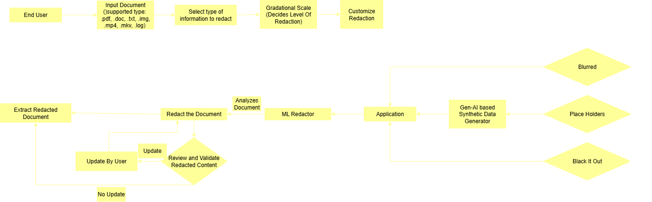
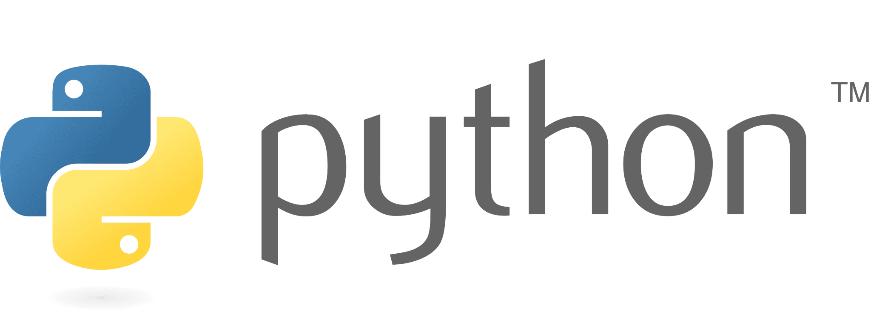




System Architecture
TechStack

Slide 5
System Architecture
End User: The process begins with the end user who needs to redact information from a document.
Input Document: The user provides an input document. This document can be in various formats such as PDF, DOC, TXT, IMG, MP4, MKV, or LOG.
Select Type of Information to Redact: The user selects the type of information that needs to be redacted from the document. This could include personal identification information, financial data, or any other sensitive information.
Gradational Scale (Decides Level of Redaction): The user decides on the level of redaction required. This could range from minimal redaction to extensive redaction, depending on the sensitivity and confidentiality of the information.
Customize Redaction: The user customizes the redaction process according to their specific needs. This could involve selecting specific areas of the document or choosing particular types of data to redact.
Redact the Document: The actual redaction process takes place.
This involves:
Placeholders: Placeholders are used to replace the redacted information with synthetic data. This ensures that the document structure remains intact and that it is clear where information has been redacted.
Blurred: One method of redaction is blurring, where sensitive information is blurred out to make it unreadable.
Black It Out: Another method of redaction is blacking out the sensitive information, making it completely unreadable.

Slide 6
System Architecture
Extract Redacted Document: Extracting the parts of the document that need to be redacted.
Analyze Document: Analyzing the document to identify and isolate the information that needs to be redacted.
ML Redactor: Using machine learning algorithms to assist in identifying and redacting sensitive information.
Application: Applying the redaction to the document.
Gen-AI Based Synthetic Data Generator: This step involves generating synthetic data to replace the redacted information if necessary. This ensures that the document remains usable and coherent even after redaction.
Review and Validate Redacted Content: The redacted document is reviewed and validated to ensure that all necessary information has been properly redacted and that the document is still functional and coherent.
Update by User: The user reviews the redacted document and can make updates if necessary. This step ensures that the user is satisfied with the redaction process.
No Update: If no updates are needed, the process moves forward.

Slide 7
FEATURES AND NOVELTY
Feature | Description
🔐 Multi-format Redaction | PDF, DOCX, Image, Excel, PPT, Video
🧠 ML-Based Smart Detection | Auto-detect PII using SpaCy, Regex, FaceNet
🧾 Consent Levels | Visible, Invisible, Masked, Crypto-token
📤 Export Anywhere | Save to cloud, IPFS, or local
🪪 Blockchain Proof | Ethereum + IPFS for data integrity
📈 Privacy-by-Design | Zero persistence, audit logging
🔁 Works Offline (Tauri) | Full functionality in desktop mode
⚡ Lightweight Extension | Chrome extension with 2-click redaction

Slide 8
DRAWBACK AND SHOWSTOPPERS
⚙️ ML Accuracy: Entity recognition errors in complex layouts
📽️ Video Redaction is Time-Consuming
🧪 Complexity in Testing: Wide variety of file types to support
🌐 Browser Limitations: Some formats need to fallback to desktop app
🔐 User Misuse: False sense of security if untrained users skip validation
Mitigated via logging, manual review options, and fallback systems.

Slide 9
RedactGuard
Member | Contact
Soham Penshanwar | sohampilot0@gmail.com 9325698118
Rasika Thakur | rasikathakur303@gmail.com 80106 85987

Slide 10
Thank you
“In a world flooded with data, the power to redact is the power to protect.”

